Slide 1


GSOC 2026 · ML4SCI PREDICT
Building & Comparing Segmentation Strategies for Coronary Artery Calcium
Road to Midterm / June 2026
CONTRIBUTOR
MENTOR
Soham Jadhav (GSoC 2026)
Katy Butler
PROJECT DOMAIN
MIDTERM EVALUATION
Deep Learning Clinical AI
July 10, 2026
PREDICT · GSOC 2026 · ML4SCI 01

Slide 2



01 WHERE WE ARE PREDICT
GSOC PIPELINE EXECUTION STATUS
Pipeline Phase Progress
Pending Deep Work
Establishing clean transformations from clinical raw formats to optimized deep training loops.
⬡
nnU-Net Implementation: Direct comparative testing
⬡
Hybrid Attention Model: Target spatial weighting layers
✔
DICOM + XML → NIfTI + Masks: Cleanly integrated & processed
✔
Exploratory Data Analysis: Verified spacing properties
Next Sprint Focus: Training on Approach 2 & 3 label strategies.
✔
Dataset Cleaning & Splitting: Extracted reliable targets
✔
Limitation Analysis: Characterized fillPoly subpixel caps
✔
3D UNet Baseline: Trained Approach 1 (Binary)
PREDICT · GSOC 2026 · ML4SCI 02

Slide 3


03 LIMITATION ANALYSIS PREDICT
LABEL-QUALITY FLOOR & CEILING
Patient Slice | Scale | fillPoly | XML (Shoelace) | Area Error
P0 (overall) | 1.28× | 34px | 20.9px² | 62.5%
P1 (z=12) | 1.03× | 28px | 25.0px² | 12.3%
P1 (z=19) | 1.03× | 16px | 15.0px² | 7.0%
P10 (z=9) | 1.18× | 32px | 20.0px² | 60.4%
P10 (z=10) | 1.18× | 42px | 23.4px² | 79.4%
High Scale Error Impact
Smaller calcium targets are artificially magnified during fillPoly rasterization, resulting in up to 79.4% discrepancy against exact mathematical Shoelace coordinates.
Highlights the necessity of subpixel loss formulations.
"This is a label-quality ceiling, not a model ceiling."
PREDICT · GSOC 2026 · ML4SCI 04

Slide 4
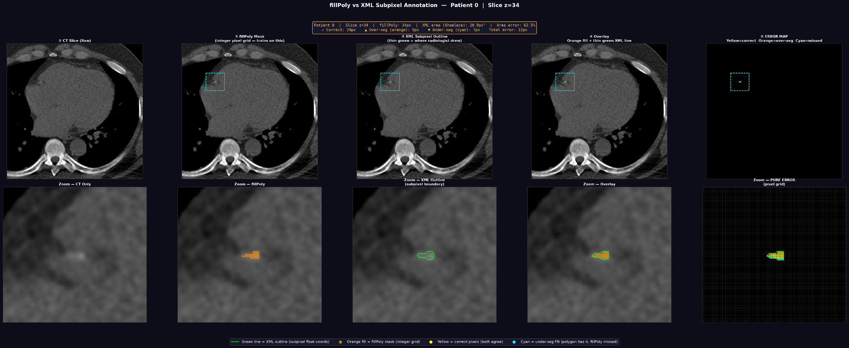






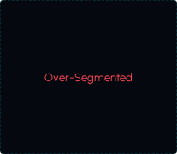


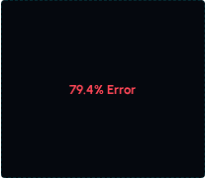
04 VISUAL EVIDENCE PREDICT
VISUALIZING SEGMENTATION BIAS
1. RAW CT
2. FILLPOLY MASK
3. XML SUBPIXEL
4. OVERLAY MAP
5. ERROR DELTA
Live Discussion Walkthrough: Examining how discrete raster borders inflate area calculation on micro-calcium spots compared to precise XML subpixel math.
PREDICT · GSOC 2026 · ML4SCI 05

Slide 5



05 LIVE DEMO PREDICT
LIVE INTERACTIVE DEMO OVERVIEW
Live Walkthrough Objectives
We will inspect edge transition behaviors in the browser sandbox to analyze:
PrediCT_Strategies.html
■
Binary quantization dropouts on boundaries
Interactive playground inspecting border pixel evaluation across 3 core segmentation label approaches:
■
Upsampling interpolation errors
■
Soft fractional target calculations
Binary Standard ➔ XML Upsampled ➔ Subpixel Coverage
Ready to Switch to Local Browser Window
PREDICT · GSOC 2026 · ML4SCI 06

Slide 6
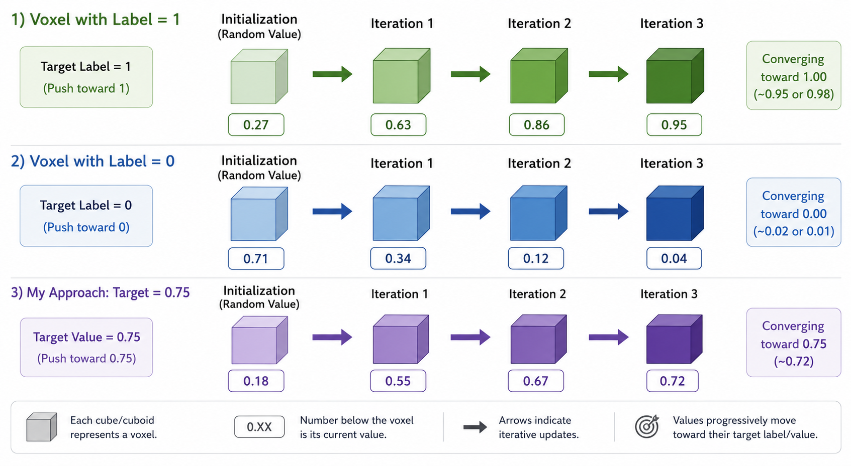

Slide 7



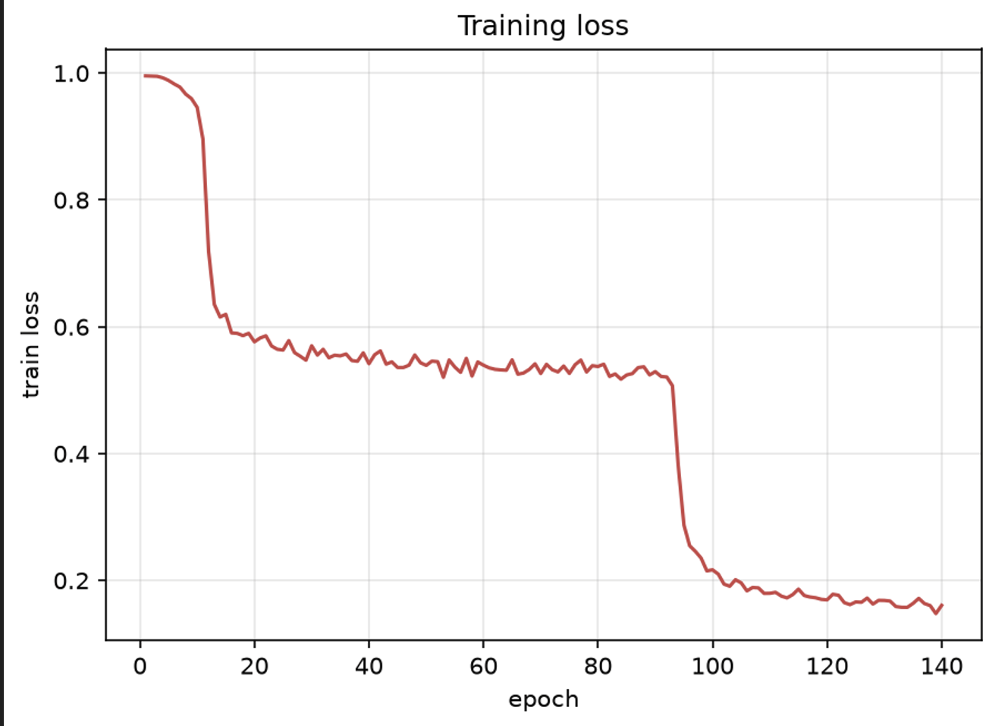
06 APPROACH 1 — BINARY PREDICT
3D UNET BASELINE PERFORMANCE
0.61
0.69
MEAN DICE
MEDIAN DICE
110/140
284m (4H 44M)
BEST EPOCH
TRAIN TIME
Convergence Trigger: Sharp performance phase transition occurs around Epoch 94. The model successfully breaks out of the default all-background prediction basin.
PREDICT · GSOC 2026 · ML4SCI 07

Slide 8
07 HOW WE GOT THERE PREDICT
CORE ARCHITECTURE ENGINEERING
Decision Made | Underlying Technical Justification | Measured Impact
HU Window [0, 1200] | Prevent contrast suppression of dense calcified plaque artifacts. | 0.25 ➔ 0.61 Dice
Tversky Loss | Focus learning objective on penalizing false negatives (high-cost misses). | Guaranteed Convergence
bfloat16 precision | Avoid immediate fp16 numerical bounds overflow causing training NaN losses. | NaNs Eliminated
PersistentDataset Cache | Bypass process-crashing overhead of multi-gigabyte RAM-caching. | RAM Overload Reduction
Persistent Workers | Resolve major CPU bottleneck issues feeding hungry GPU architecture. | 125s ➔ 88s per Epoch
PREDICT · GSOC 2026 · ML4SCI 08

Slide 9


08 CREDIBILITY CHECK PREDICT
TRANSPARENT PERFORMANCE METRICS
0.69 Median
Full-Volume Inference Constraints
■
No ROI Cropping: Inference occurs over the complete thorax. The model cannot take cheats from localized cardiovascular Crops.
Most Scans Segment Well
The median score (0.69) sitting well above the mean (0.61) indicates excellent, robust fits on standard clinical data.
■
Rigorous Rejection Demands: The pipeline tests target selectivity strictly, forcing the network to reject every surrounding rib, sternum, and vertebra.
A tough minority of low-calcium outlier cases heavily drags the absolute mean down.
Provides a highly honest, clinically accurate performance report.
■
PREDICT · GSOC 2026 · ML4SCI 09

Slide 10






10 ROADMAP PREDICT
PATH TO MIDTERM: JULY 10, 2026
Baseline Trained
Label Gen Appr. 2/3
UNet 3-Strategy Run
Agatston Extraction
Soft Scorer Dev
Midterm Deliverable
Completed
June 26-28
June 29-Jul 2
July 7-8
July 8-9
July 10
Upcoming Core Focus: Compiling final Dice comparison table across Binary, Upsampled, and Coverage Fraction annotation maps.
PREDICT · GSOC 2026 · ML4SCI 11

Slide 11


11 EXPECTATIONS PREDICT
TARGET METRICS EVALUATION
Validation Dice Scores
Agatston Score MAE
Our current performance is aligning smoothly to meet target criteria:
Evaluating predicted mass scoring bounds on test holdouts:
■
Minimum Acceptable: ≥ 0.65
■
Minimum Acceptable: MAE < 50
■
Midterm Target Goal: ≥ 0.75
■
Midterm Target Goal: MAE < 25
■
Current Status: 0.61 Mean / 0.69 Median
■
Current Status: Pending evaluation pipeline
PREDICT · GSOC 2026 · ML4SCI 12

Slide 12

12 OPEN QUESTIONS PREDICT
ACTIVE DISCUSSION POINTS
Questions and Discussion
■
[ IMP ] Testing and Validation: What we are comparing with fill poly or xml for testing.
■
Patient 263 presents recurring pipeline data corruption anomalies. Should we exclude permanently, or keep debug resources allocated?
■
The specific IDs of the 2 flagged patients
PREDICT · GSOC 2026 · ML4SCI 13

Slide 13
ACTIVE DISCUSSION POINTS
Thank You…

